Slide 1
TEAM MEMBERS Name : Surya narayanan V Reg .No : 312321202059 Name : Venkat S Reg .No : 312321202061 UNDER THE GUIDANCE OF k.bhuvaneswari M.tech
A Novel Approach for Smart Farming Solutions:Crop Recommendations,Yield

Slide 2
OBJECTIVE
To develop an AI-powered Smart Farming Assistant that leverages Machine Learning (ML) for optimizing crop selection, yield forecasting, and disease detection.
To enhance efficiency and sustainability in Agriculture.

Slide 3
ABSTRACT
The Smart Farming Assistant integrates AI, ML, and real-time agricultural data to provide predictive insights.
It uses algorithms like Random Forest, SVM, and Gradient Boosting to analyze weather, soil, and crop health data.
The system offers crop recommendations, yield forecasts, and disease detection through a cloud-based web platform, aiding farmers in informed decision-making.

Slide 4
PROBLEM STATEMENT
Traditional farming methods lack predictive capabilities, making it difficult for farmers to forecast yields, detect diseases early, and optimize crop selection.
Without AI-driven insights, agricultural productivity remains inconsistent and resource-intensive.

Slide 5
LITERATURE SURVEY
AUTHOR ,YEAR | TITLE | CONCEPT | PROS AND CONS
Reyana et al.., 2023 | Accelerating Crop Yield: Multisensor Data Fusion and Machine Learning for Agriculture Text Classification | Uses multisensor data and machine learning to classify agricultural texts and recommend crops. | Pros: Strong performance on various NLP tasks, contextualized embeddings. Cons: Computationally intensive, fine-tuning required.
R. Gupta et a., 2021 | WB-CPI: Weather-Based Crop Prediction in India Using Big Data Analytics | Analyzes weather data (rainfall, temperature, humidity) using MapReduce and K-means for crop prediction. | Pros: Efficient for large-scale data analysis. Cons: Performance depends on accurate weather forecasting.

Slide 6
LITERATURE SURVEY (contd,.)
AUTHOR ,YEAR | TITLE | CONCEPT | PROS AND CONS
Tussupov et al.,2024 | Analysis of Formal Concepts for Verification of Pests and Diseases of Crops Using Machine Learning Methods | Uses spectral brightness coefficients and ML models like XGBoost and CNN to classify pest-infected crops. | Pros: Helps early pest detection. Cons: Accuracy may vary based on image quality.
J. Tussupov et al.,2024 | Verification of Pests and Diseases of Crops Using Machine Learning | Applies ML techniques to analyze spectral data for pest classification in agriculture. | Pros: Reduces costs for pest management. Cons: Requires high-quality datasets for training.

Slide 7
LITERATURE SURVEY (contd.,)
AUTHOR ,YEAR | TITLE | CONCEPT | PROS AND CONS
E. Moupojou et al.,2023 | FieldPlant: A Dataset of Field Plant Images for Plant Disease Detection and Classification | Introduces FieldPlant dataset for training deep learning models to detect plant diseases in real-world images. | Pros: Enhances precision in crop classification and prediction. Cons: Requires extensive sensor deployment and data processing.
K. M. Hosny et al.,2023 | Multi-Class Classification of Plant Leaf Diseases Using Feature Fusion | Combines CNN and Local Binary Pattern (LBP) features for disease classification. | Pros: High accuracy in disease classification. Cons: Requires computational resources for deep learning.

Slide 8
LITERATURE SURVEY (contd.,)
AUTHOR ,YEAR | TITLE | CONCEPT | PROS AND CONS
D. S. Joseph et al.,2024 | Real-Time Plant Disease Dataset Development and Detection | Develops a dataset for rice, wheat, and maize disease detection using deep learning. | Pros: Helps diagnose common crop diseases. Cons: Limited to specific crops and diseases.
A. Bhargava et al.,2024 | Plant Leaf Disease Detection and Classification Using AI | Reviews AI and computer vision techniques for detecting plant diseases from leaf images. | Pros: Enables automated disease identification. Cons: Dependence on labeled datasets.

Slide 9
LITERATURE SURVEY (contd.,)
AUTHOR ,YEAR | TITLE | CONCEPT | PROS AND CONS
V. Balafas et al.,2023 | Machine Learning for Plant Disease Classification and Detection | Uses deep learning models for precision agriculture and plant disease identification. | Pros: Provides scalable disease detection. Cons: Requires high computational power.
J. Tussupov et al.,2024 | Verification of Pests and Diseases of Crops Using Machine Learning | Applies ML techniques to analyze spectral data for pest classification in agriculture. | Pros: Reduces costs for pest management. Cons: Requires high-quality datasets for training.

Slide 10
SUMMARY OF LITERATURE SURVEY
This literature survey encompasses 11 articles focused on diverse aspects of financial document analysis and Large Language Model (LLM) technology.
Several articles discuss the application of LLMs and advanced NLP techniques for financial text processing and information extraction, while others explore the use of conversational AI and chatbots for enhancing user interaction with financial data.
Some articles focus on specific financial tasks, such as sentiment analysis of financial news or risk assessment using machine learning models, and the ethical considerations surrounding LLMs in finance.
Overall, the articles highlight the potential benefits of LLMs and AI-driven solutions for improving efficiency, accuracy, and accessibility in financial document analysis, contributing to more informed decision-making and streamlined workflows

Slide 11
.
EXISTING METHODOLOGY
Manual Crop Monitoring – Farmers depend on personal experience and visual inspection to assess crop health, leading to human errors.
Basic Sensor-Based Systems – Isolated IoT sensors collect environmental data (e.g., soil moisture, temperature) but lack predictive analytics.
Standalone Mobile Applications – Provide generic crop recommendations but do not integrate real-time data or AI-driven predictions.
Traditional Yield Forecasting – Based on historical trends without considering dynamic environmental changes, leading to inaccurate predictions.
Reactive Disease Management – Pesticides and treatments are applied after visible symptoms appear, increasing losses.
Limited Data Utilization – Existing systems do not leverage machine learning for pattern detection and predictive insights.

Slide 12
PROPOSED METHODOLOGY
User-Friendly Conversational AI
Aims to provide a clean, intuitive, and interactive interface for financial document analysis.
Integration of LLMs & RAG
Utilizes Large Language Models (LLMs) combined with Retrieval-Augmented Generation (RAG) for enhanced user interaction.
Natural Language Query Processing
Users can ask questions in natural language regarding financial documents.
Contextual & Concise Responses.
The system retrieves relevant document sections using RAG and generates precise answers via LLM, ensuring accurate and context-aware responses

Slide 13
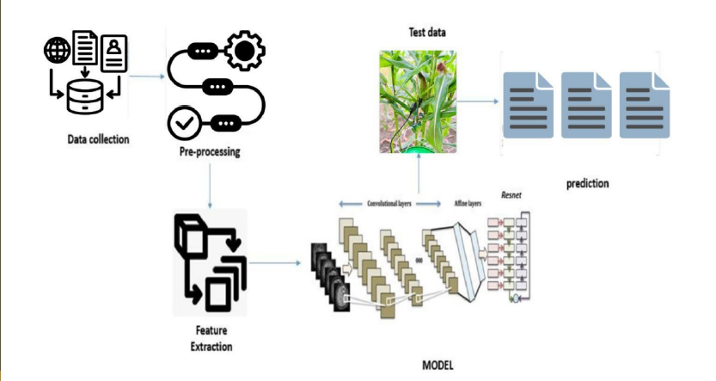
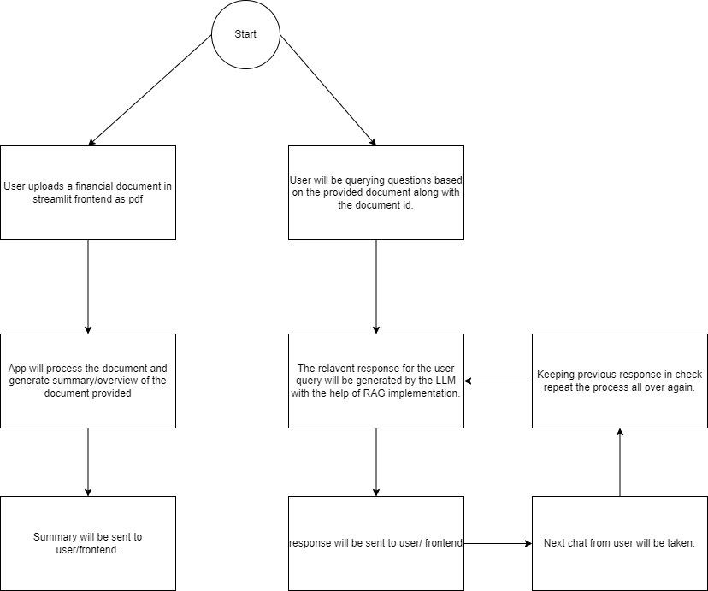
ARCHITECTURE DIAGRAM

Slide 14
LIST OF MODULES
Authentication – Manages user registration, login, and secure access control.
Data Collection – Gathers real-time and historical data from IoT sensors and user inputs.
Data Processing & Analytics – Cleans, organizes, and analyzes data using machine learning models.
Prediction & Visualization – Provides crop recommendations, yield forecasts, and disease detection with interactive dashboards

Slide 15
H/W AND S/W REQUIREMENTS
HARDWARE TOOLS
Processor: Intel i5 or higher
RAM: 4GB or above
Storage: 40GB HDD/SSD or more
Sensors: IoT-based soil moisture, temperature, and weather sensors (if applicable)
Internet Connectivity: Required for cloud-based operations
SOFTWARE REQUIREMENTS
Operating System: Windows XP or later
Programming Language: Python
Web Framework: Flask
Database: MySQL
Frontend Technologies: HTML, CSS, JavaScript
ML Libraries: TensorFlow, Keras, Pandas, NumPy
Development Tools: Jupyter Notebook, VS Code

Slide 16
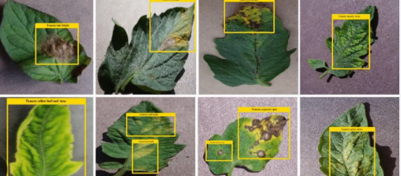
Leaf Disease Detection
SFAMS predicts crop diseases using CNN-based image analysis:
Farmers upload leaf images.
The system extracts features (color, texture, lesions) to detect diseases.
Provides real-time alerts with disease names, severity levels, and treatment recommendations.

Slide 17

Chatbot Integration
AI-powered chatbot provides real-time guidance on farming practices in multiple languages.
Uses NLP for crop recommendations, yield predictions, and disease alerts.
Farmers can upload field data and export reports (CSV format).

Slide 18

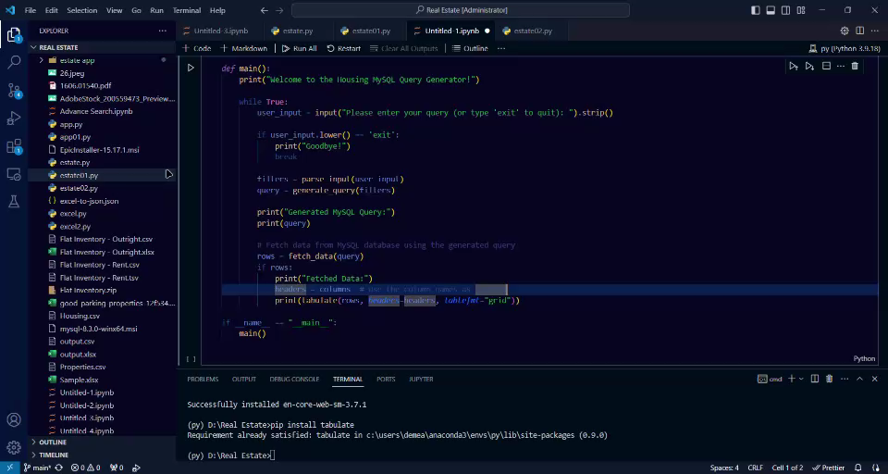
OUTPUT
OUTPUT

Slide 19
CONCLUSION
This project developed a comprehensive model for predicting and managing agricultural outcomes, focusing on crop recommendations, yield predictions, and disease classification.
By leveraging advanced machine learning and deep learning techniques, the system effectively integrated multimodal data sources, including real-time sensor data, historical agricultural records, and environmental conditions, to provide precise insights for various farming scenarios.

Slide 20
FURTURE ENHANCEMENTS
Soil & Weather Data: Adding real-time soil moisture and weather updates improves crop and disease predictions, helping farmers make better decisions.
IoT Monitoring: Using IoT sensors for real-time field tracking ensures timely actions, reducing losses.
Explainable AI: Making AI decisions clearer helps farmers trust and understand recommendations.
Crop Expansion: Enhancing the model to support more crop types makes SFAMS more useful for diverse farms

Slide 21
REFERENCES
[1] Reyana, S., Kautish, P. M. S., Karthik, I. A., Al-Baltah, M. B., Jasser, & Mohamed, A. W. (2023). Accelerating Crop Yield: Multisensor Data Fusion and Machine Learning for Agriculture Text Classification. IEEE Access, 11, 20795-20805. doi: 10.1109/ACCESS.2023.3249205.
[2] Gupta, R., et al. (2021). WB-CPI: Weather-Based Crop Prediction in India Using Big Data Analytics. IEEE Access, 9, 137869-137885. doi: 10.1109/ACCESS.2021.3117247.
[3] Tussupov, J., et al. (2024). Analysis of Formal Concepts for Verification of Pests and Diseases of Crops Using Machine Learning Methods. IEEE Access, 12, 19902-19910. doi: 10.1109/ACCESS.2024.3361046.

Slide 22
REFERENCES (contd,.)
[4] Moupojou, E., et al. (2023). FieldPlant: A Dataset of Field Plant Images for Plant Disease Detection and Classification With Deep Learning. IEEE Access, 11, 35398-35410. doi: 10.1109/ACCESS.2023.3263042.
[5] Hosny, K. M., El-Hady, W. M., Samy, F. M., Vrochidou, E., & Papakostas, G. A. (2023). Multi-Class Classification of Plant Leaf Diseases Using Feature Fusion of Deep Convolutional Neural Network and Local Binary Pattern. IEEE Access, 11, 62307-62317. doi: 10.1109/ACCESS.2023.3286730.
[6] Joseph, D. S., Pawar, P. M., & Chakradeo, K. (2024). Real-Time Plant Disease Dataset Development and Detection of Plant Disease Using Deep Learning. IEEE Access, 12, 16310-16333. doi: 10.1109/ACCESS.2024.3358333.

Slide 23
Thank you

